Slide 1
Week 4

Slide 2
Overview
Introduction to SVM
Programming Implementation
Introduction to KNN
Programming Implementation

Slide 3
Support Vector Machines
Find the dividing hyperplane that splits the classes with the maximum margin
Maximum margin is measured by the distance between the two ‘closest’ points from each class, which are known as the support vectors
Hyperplane for each support vector constructed using parallel lines to the dividing hyperplane, that pass through each support vector
Find distance between support vector hyperplanes → subtract y-intercept
Minimizing this distance involves optimization, which is solved by the Karush-Kuhn-Tucker (KKT) conditions, using Lagrange multipliers → similar to Logistic Regression optimization
If all points cannot be classified by a dividing hyperplane (i.e. the support vectors fall on the same side), we can penalize this differently (use diagram to demonstrate)

Slide 4
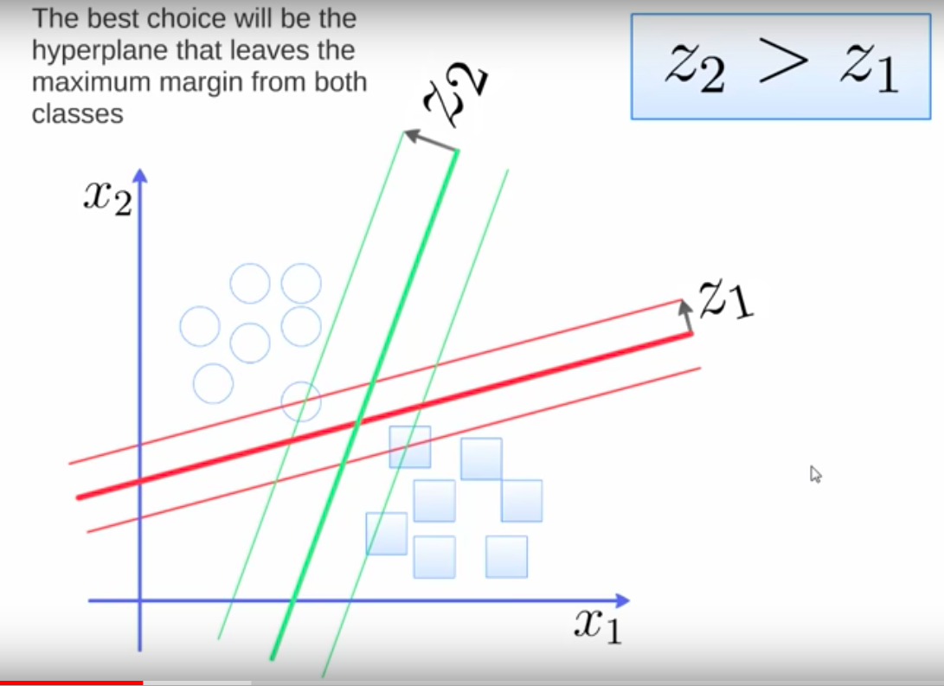
SVM Visualization

Slide 5
Programming Implementation

Slide 6
K-Nearest Neighbours
Choose k number of neighbours (usually around 1 per 100 data points, or just 5)
Plot new test data point on graph that has all training points
Take the k nearest neighbours according to distance metric (eg. Euclidean, Manhattan)
Among the k neighbours, count the number of data points in each category
Assign new data point to category with most neighbours

Slide 7
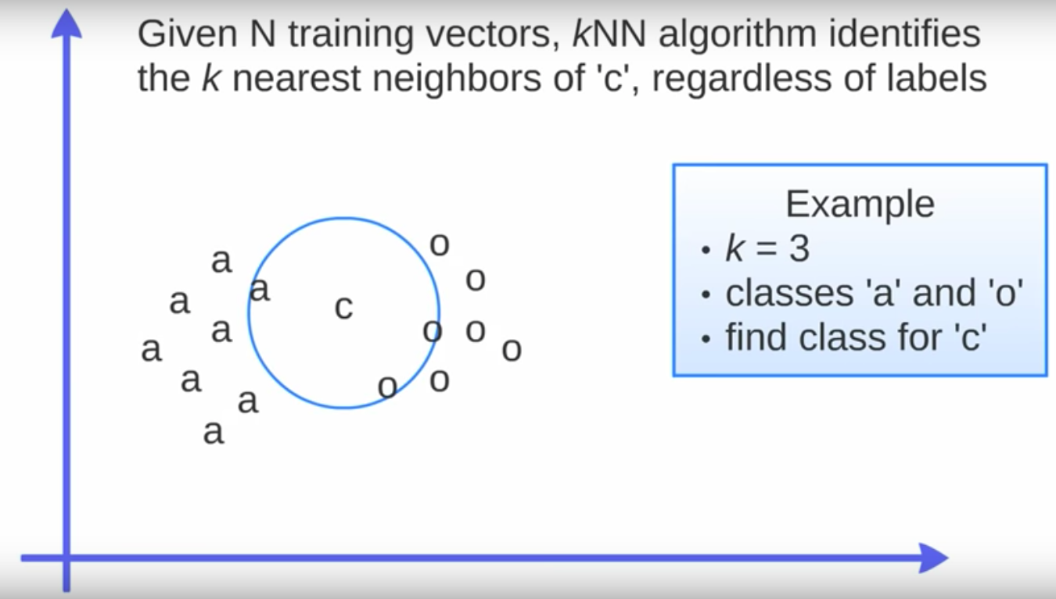
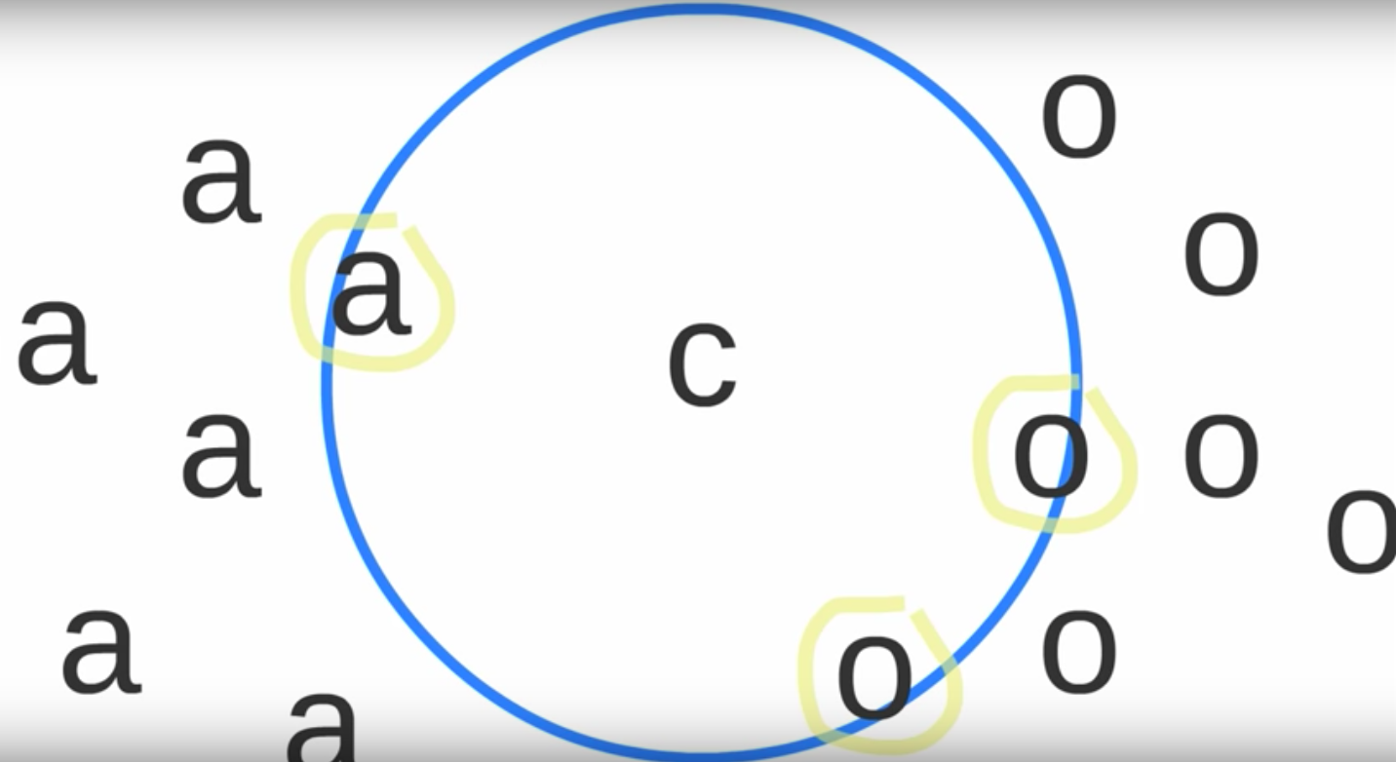
KNN Visualization

Slide 8
Programming Implementation

